Slide 1
Think Like a Reporter Effective communication with media
Aaron Sadler, media relations specialist
Notes:
Provide quick background on myself and company

Slide 2
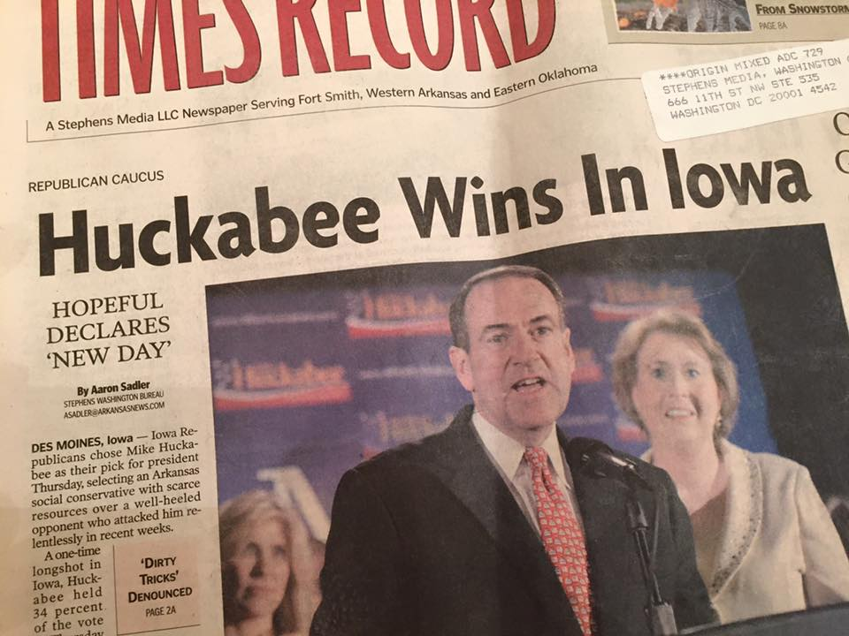
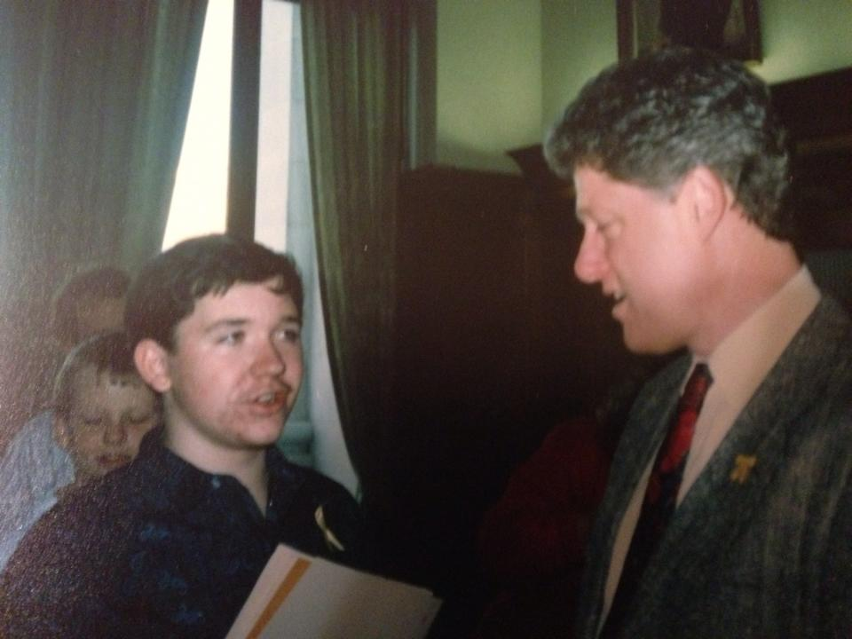
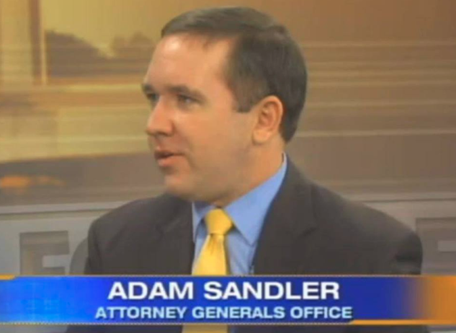
Me
Former political reporter
25-year communications career
Stints at four AG’s offices (AR, PA, LA, MS)

Slide 3
Not Me
Notes:
Add content marketing video of me

Slide 4
Think About Reporters
nosy? lazy?
dishonest? mean?
rude? stupid?
difficult? arrogant?
Notes:
Dec. 2015 Gallup Poll-
30 percent of Americans rate honesty and ethical standards of reporters as low/very low --- 34 percent say the same for attorneys

Slide 5
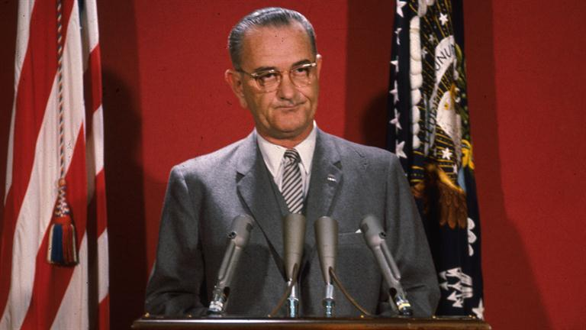
Think About Reporters
Lyndon Johnson:
If one morning I walked on top of the water across the Potomac River, the headline that afternoon would read,
'President Can't Swim.’

Slide 6
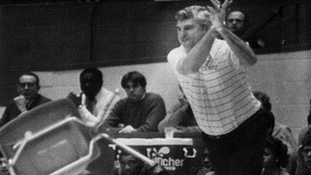
Think About Reporters
Bobby Knight:
All of us learn to write by the second grade, then most of us go on to other things.
Notes:
.

Slide 7
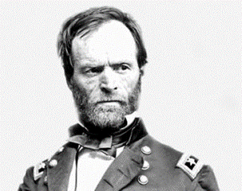
Think About Reporters
Gen. William Sherman:
If I had my choice, I would kill every reporter in the world. But, I am sure we would be getting reports from Hell before breakfast.

Slide 8
Think About Reporters
overworked
overwhelmed
underpaid
underemployed
exhausted
stressed
(“Journalist” was CareerCast.com’s worst job in America, 2013)

Slide 9
Think About Reporters
Reporters say their job is the worst because of:
low pay
high stress
long hours
fewer job openings
higher demands
uncertainty
(Source: Poynter.org)

Slide 10
Think About Reporters
Typical newspaper reporter daily schedule:
8:30: Calls to sources
9:00: Meeting with editors
9:30: Appointments/Interviews
10:00: Begin draft of day’s 1st story; publish to internet/social media
11:30: Luncheon/Interviews for 2nd story
1:00: Finish first story; start second; publish to internet/social media
3:00: Meeting with editors
3:30: DEADLINE for final first article
5:00: DEADLINE for final second article
6:00: Blog about your day
6:30: Work on in-depth weekend article

Slide 11
Good News and Bad News
Bad News First:
As demands on reporters increase, so does the difficulty and obligation to communicate effectively with media

Slide 12
Good News and Bad News
Good News:
The media and the public need concise, effective messages from thought leaders.

Slide 13
Good News and Bad News
More Good News:
Get unfiltered messages to the masses when you think like a reporter

Slide 14
Think Like a Reporter
Reporter Truths
The job is life
They want to get it right
They need your help
Notes:
ASU DC event story-
They care about their communities & what they’re covering

Slide 15
Think Like a Reporter
Reporter Fake News
They’re out to get you
They’re just trying to sell papers/drive ratings
Their world view = your world view
Notes:
ASU DC event story

Slide 16
Think Like a Reporter
Three-step Game Plan
Anticipate
Evaluate
Execute
Notes:
ASU DC event story-
They care about their communities & what they’re covering

Slide 17
Think Like a Reporter: Anticipate
Take nothing for granted
County judges don’t wear robes
Ad Valorem is not the latest Dan Brown novel
Records aren’t just vinyl
Notes:
ASU DC event story-
They care about their communities & what they’re covering

Slide 18
Think Like a Reporter: Anticipate
Prepare for anything
You aren’t the only person a reporter talks to
Do you have a communications plan?
What about your elevator pitch?
Notes:
ASU DC event story-
They care about their communities & what they’re covering

Slide 19
Think Like a Reporter: Evaluate
Research your reporter
Read/watch previous coverage
Follow social media
Find common connections
Notes:
ASU DC event story-
They care about their communities & what they’re covering

Slide 20
Think Like a Reporter: Evaluate
Research your topic
Find supporting documents
Find supporting sources
FOIA is your friend
Notes:
ASU DC event story-
They care about their communities & what they’re covering

Slide 21
Think Like a Reporter: Evaluate
Research your format/setting
Where are you most comfortable?
Phone or in person?
Interview or news conference or statement?
Notes:
ASU DC event story-
They care about their communities & what they’re covering

Slide 22
Think Like a Reporter: Execute
Some general strategies
Avoid jargon
Silence is sometimes golden
Speak to your audience
Repeat, repeat, repeat
Speak in sound bites
First things first, best things last
Notes:
ASU DC event story-
They care about their communities & what they’re covering

Slide 23
Think Like a Reporter: Execute
Notes:
ASU DC event story-
They care about their communities & what they’re covering

Slide 24
Think Like a Reporter: Execute
Messaging
Stick to just a few key messages
Enhance those messages with supporting information and anecdotes
Use colleagues/staff as sounding board for talking points
Notes:
ASU DC event story-
They care about their communities & what they’re covering

Slide 25
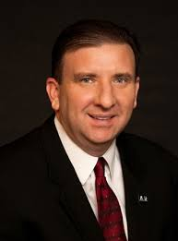
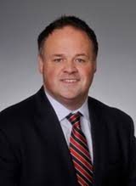
Think Like a Reporter: Execute
“Bridge” those troubled waters
A case study: Broadway v. Darr
Notes:
ASU DC event story-
They care about their communities & what they’re covering

Slide 26
Think Like a Reporter: Execute
Bridging and Transitions
“We find the more important issue is…”
“I think it would be more accurate (or correct) to say…”
“Here’s the real problem…”
“What I’ve said comes down to this…”
“Let me emphasize again…”
“What matters most in this situation is…”
Notes:
ASU DC event story-
They care about their communities & what they’re covering

Slide 27
Think Like a Reporter: Execute
As seen on TV
Use memorable words
Body language speaks volumes
Look at the interviewer, not the camera
Wear neutral colors (no crazy patterns)
Take advantage of set-up time
Notes:
Talledega nights

Slide 28
Think Like a Reporter: Execute
And heard on the radio
Stick to landlines when calling in
Avoid distractions
Keep your notes handy
Notes:
Talledega nights

Slide 29
Think Like a Reporter: Execute
Misc. Tips
Practice, practice, practice
Consider blogger lunches, reporter roundtables
Be friendly, not friends
Notes:
Talledega nights

Slide 30
Think Like a Reporter: Conclusion
Anticipate a reporter’s needs
Evaluate your response
Execute a successful strategy when you
Think Like a Reporter
Notes:
Talledega nights

Slide 31
Thank you! Aaron Sadler aaron@ghidotticommunications.com 202.230.8282

