Slide 1
UPDATING DRUG TESTING POLICIES

Slide 2
DRUG FREE WORKPLACE ACT
The Drug Free Workplace Act of 1988 requires all federal grant recipients to establish and enforce zero tolerance drug policies.
Any employer that fails to adhere to the requirements of the Drug Free Workplace Act risks payments for grant activities being suspended, the whole grant being suspended or terminated, or the grantee being prohibited from receiving any federal grants for up to five years.
Requirements of Drug Free Workplace Act
Publish and give a policy statement informing all employees that the unlawful manufacture, distribution, or possession or use of a controlled substance is prohibited in the workplace and specify the consequences for violation of the policy.
Establish a drug-free awareness program- inform employees of the dangers of drug abuse; the policy maintaining a drug-free workplace; the availability of drug counseling, rehabilitation, and employee assistance programs (EAP); and the penalties that may be imposed for drug abuse violations.
Employees must notice their employer within 5 calendar days if convicted of a criminal drug violation in the workplace.
Within 10 days after receiving notice that an employee has been convicted, the employer must notify the granting agency.
Employer must impose a penalty on, or require participation in a drug abuse assistance or rehabilitation program, any employee that is convicted of a reportable workplace drug conviction.
Must make a good faith effort to maintain a drug-free workplace by meeting the requirements of the Act.

Slide 3
Fourth Amendment Considerations for Public Employers
Drug testing is considered a “search” according to the 4th Amendment
Each test must pass a balancing test. Skinner v. Railway Labor Executives’ Assn. & National Treasury Employees v. Von Raab
Their must be a compelling governmental interest that outweighs the intrusion of the employee’s privacy. Employee testing groups must be narrowly tailored to the governmental interest
Must first determine why it is necessary to test each particular group
Is there a documented drug or alcohol problem in a particular work group?
Is the group performing duties that are “fraught with such risks of injury to others that even a momentary laps of attention can have disastrous consequences”?
Examples where the US Supreme Court has found compelling governmental interests
Train operators
Nuclear power plant operators
Customs agents who are directly involved in drug interdiction and/or carry firearms

Slide 4
Explicit Employee Protections of Act 593 of 2017
Anti-discrimination provisions prohibit all adverse employment actions against employees based solely on participation in medical marijuana program
Require a showing of impairment before taking adverse employment action
OTHER CONSIDERATIONS:
Due Process Clause and Equal Protection Clause
Americans with Disabilities Act
Does not protect employees engaging in current illegal use of drugs
Arkansas Civil Right Act
Protects against discrimination on the basis of disability in the workplace

Slide 5
Types of Testing
Job Applicants/Pre-employment
Employees who are reasonably suspected to be impaired as a result of drug or alcohol use
Random
Employees involved in an accident or incident
Return to duty
Follow-up

Slide 6
Types of Testing
Pre-employment Testing
Preformed after a conditional offer of employment has been made
Wholesale testing of applicants for government employment without regard to the nature of the position has not been up upheld. Chandler v. Miller
Pre-employment testing should be used only for applicants who will occupy Department of Transportation/Federal Motor Carrier Safety Administration’s covered positions and safety sensitive positions
Reasonable Suspicion Testing
Reasonable suspicion testing must be based upon individualized suspicion of on-duty drug use or impairment, which is documented by a trained supervisor
Uncorroborated tips and hunches are not enough
Post Accident Testing
Must be specific about who must be tested
Testing is overbroad when it includes all employees in a vehicle, even those whom the facts indicated could not have caused the accident. Plane v. United States
Setting a policy with a limit on damages, such as in excess of $1,000, may be difficult to administer and may be determined by a court to be of an insufficient magnitude to provide probable cause to search. Connelly v. Newman

Slide 7
Types of Testing
Random Testing
It acts as a deterrent because employees know they will be tested, but they do not know when
Must be a position that constitutes a sufficient public safety concern, such as operating heavy machinery
Has been upheld when there is front-line drug interdiction, carrying a firearm, and sensitive classified information affecting national security
Courts have been reluctant to allow for driving a vehicle where no passengers are involved, such as mail carriers or messengers. AFGE v. Sullivan
At least one Court ruled that operating a passenger motor vehicle was no greater risk than everyone runs when driving a car. National Treasury Employees Union v. Watkins
Mostly allowed when driving vehicles other than passenger cars and/or carrying significant number of passengers
Certified law enforcement carrying weapons & working in drug interdiction, 911 operators, jail deputies with direct contact with prisoners, mechanics, road and bridge crews, sanitation crews, CDL holders mandated by DOT & FMCSA (Federal Motor Carrier Safety Administration) regulations
Return to Duty Testing & Follow-up Testing
Required by DOT/FMCSA
Good idea to limit substance abuse and ensure an unimpaired workforce

Slide 8
Arkansas Medical Marijuana Amendment
In order to take adverse employment action, the employer must have proof of the employee’s public/workplace use OR proof of being under the influence.

Slide 9
SAFETY SENSTIVE POSITIONS as Defined by Act 593 of 2017
Any position involving a safety sensitive function pursuant to federal regulations governing drug and alcohol testing adopted by the US DOT or another federal agency…
Also means any position designated in writing by an employer as a safety sensitive position in which a person performing the position while under the influence of marijuana may constitute a threat to health or safety, including without limitation:
(i) a position that requires: (1)carrying a firearm; (2) performing life-threatening procedures; (3) working with confidential information or documents pertaining to criminal investigations; (4) working with hazardous or flammable material; controlled substances, food, or medicine; or
(ii) in which the lapse of attention could result in injury illness, or death, including without limitation a position that includes the operating, repairing, maintaining, or monitoring of heavy equipment, machinery, aircraft, motorized watercraft, or motor vehicles as part of the job duties.

Slide 10
Symptoms Causing a REASONABLE SUSPICION of being UNDER THE INFLUENCE as Defined by Act 593 of 2017
Under the Influence means symptoms of the current use of marijuana that may negatively impact the performance of the job duties or tasks or constitute a threat to health or safety and includes without limitation:
(i) symptoms of the applicant’s or employee’s speech, walking, standing, physical dexterity, agility, coordination, actions, movement, demeanor, appearance, clothing, odor, or other irrational or unusual behavior that are inconsistent with the usual conduct of the applicant or employee;
(ii) negligence or carelessness in operating equipment, machinery or production or manufacturing processes;
(iii) disregard for safety;
(iv) involvement in an accident that results in:
(a) damage to equipment, machinery, or property;
(b) disruption of a production or manufacturing process; or
(c) an injury; or
(v) other symptoms causing a REASONABLE SUSPICION that the current use of marijuana may negatively impact the performance of the job duties or tasks or constitute a threat to health or safety.

Slide 11
Proof of Current Use of Marijuana Justifies the GOOD FAITH BELIEF of Employer Pursuant to Act 593 of 2017
Good Faith means reasonable reliance on a fact without the intent to deceive or be deceived and without reckless or malicious disregard for the truth.
May be based on the following:
1. observed conduct, behavior, or appearance;
2. information reported by a person believed to be reliable, including without limitation a report by a person who witnessed the use or possession of marijuana or paraphernalia by an applicant or employee in the workplace;
3. written, electronic or verbal statements from the employee or other persons;
4. lawful video surveillance;
5. a record of government agencies, law enforcement agencies, or courts;
6. a positive test result for marijuana;
7. a warning label, usage standard, or other printed material that accompany instructions for usable marijuana;
8. information from a physician, medical review officer, or a dispensary;
9. information from reputable reference sources in print or on the internet;
10. other information reasonably believed to be reliable or accurate.

Slide 12
Actions That Will Not Constitute a Cause of Action
A cause of action may not be established against an employer for:
Establishing a substance abuse or drug free workplace policy
Acting on the employer’s good faith belief that a qualifying patient either possessed, used, or was under the influence of marijuana while on the premises of the employer or during working hours, as long as a positive test result for marijuana was not the sole basis for the good faith belief
Excluding a qualifying patient from being employed in or performing a safety sensitive position based on the good faith belief that the qualifying patient was engaged in the current use of marijuana.

Slide 13
How to Document Reasonable Suspicion
1. Receiving Complaints- Often concerns come from co-workers. Do not want to send an employee for testing based on hearsay or gossip, but a supervisor should document the complaint/concern. Ask what was observed, when it was observed, and if others witnessed it and document it.
2. Observation by Supervisor- Immediately upon notice, a supervisor should go to the employee’s work area for first hand observation. May be able to observe from afar, but will meet to talk to employee directly to observe smell of alcohol, eye dilation, slurred speech and/or other behaviors.
3. Remove Employee from Safety Sensitive Duties and/or Areas- If employee works in a safety sensitive area and/or job, or causing others a safety concern, remove employee from area to an office or conference room.
4. Observation by Another Supervisor- Seek a second trained supervisor to confirm initial suspicions. The second supervisor should perform his/her own firsthand observation.
5. Both observers should clearly document their observations.

Slide 14
6. Assess the Situation- Consult with HR and assess what is known. If both observers witnessed behaviors that create suspicion, move on to next step. If there isn’t agreement, may need to bring in a third trained observer.
7. Meet with the Employee- Supervisor or HR should meet with employee with a witness. Clearly explain what had been observed and documented. Explain that the employee will be sent for a drug and alcohol test in order to rule out the possibility that the employee is in violation of the County’s personnel policy. This will indicate that this is a procedural requirement and if the employee is not under the influence of drugs or alcohol, the test will prove this.
8. Arrange Transportation- The employee should be driven to the testing facility and home afterward.
9. Send for Testing- Notify the testing facility the employee is on the way for reasonable suspicion testing.
10. Wait for Results- The policy should address what the employee should do in the interim and whether or not the time will be paid leave. In most cases, the employer does not want the employee to return to work.
11. Refused testing- The policy should indicate that refusing to take a test will result in a positive drug result and result in immediate termination.

Slide 15
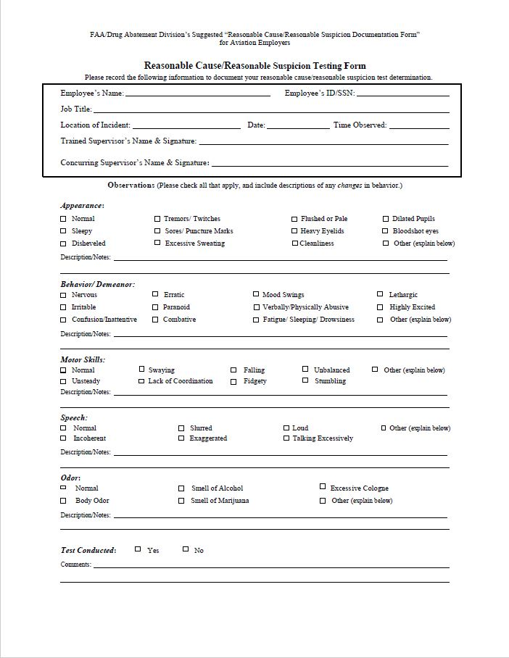
Reasonable Suspicion Testing Form
Employee information
Time of observation
Location
Checklist for Observations
Supervisor & Witness signature
To the best of my knowledge and belief, this report represents the physical, behavioral, speech, or performance indicators of the above-named employee, observed by me and upon which I base my decision to require said employee to submit to a reasonable suspicion drug test.

Slide 16
POSITIVE TEST RESULTS, NOW WHAT?
If an employee tests positive for marijuana, the MRO will report the result as positive.
The MRO will inform the employer that the employee claims to be holder of a medical marijuana identification card.
It will be up to the employer to verify the employee’s cardholder status.
View the card
Do not ask the reason for being a cardholder
However, depending upon how the employer policy is written, it may be irrelevant.
If the employee is in a safety sensitive position, termination or disciplinary action consistent with the employer policy may be appropriate.

Slide 17
Pre-employment test- A positive drug test CANNOT be the sole basis for denying employment EXCEPT when the employer is bound by federal drug testing requirements, the job is classified as safety sensitive, or if the employee is not a qualifying patient.
Reasonable Suspicion Test- A positive drug test CAN support a good faith belief that the employee is under the influence, resulting in an employment action consistent with the personnel policy.
Post-Accident Test- A positive drug test CAN, along with an accident that caused an injury or damage, support a good faith belief that the employee is under the influence, resulting in an employment action consistent with the personnel policy.
Random Test- A positive drug test CANNOT be the sole basis for an employment action EXCEPT when the employer is bound by federal drug testing requirements, the job is classified as safety sensitive, or if the employee is not a qualifying patient.
Return to Duty & Follow-Up Tests- A positive test CAN be the sole basis for an employment action.

Slide 18
HOW TO DEVELOP A DRUG TESTING PROGRAM
Decide how your county wants to handle drug and alcohol testing in your personnel policy
Who is to be tested and why is it necessary to test each particular group?
Is there a documented drug or alcohol problem in the particular workforce?
Are the duties fraught with such risks of injury to others that a momentary lapse of attention could have disastrous consequences?
Is there a less intrusive means to accomplish the same purpose?
Is direct supervision practical or is the group alone for long periods of time without supervision?
Do you want to accommodate medical marijuana?
An employer never has to allow marijuana use at place of work or impairment on the job
Off-duty use of marijuana, without a registration card issued by the Department of Health, is still illegal
Must you have a zero tolerance policy?
Have a written policy
Train supervisors regarding the policy and provide annual training on reasonable suspicion
Inform employees of the policy and have them sign an acknowledgment
Have safety sensitive employees sign a specific acknowledgement that they are aware they position is safety sensitive and they will be subject to additional testing, i.e. pre-employment, random, return to duty and follow-up

Slide 19
DRUG TESTING POLICIES
Be Explicit
Who is subject to testing?
How will it be administered?
Consequences of positive results
Be clear and transparent
How will testing be conducted?
Urine, hair, saliva? Urine is used by the DOT and is the gold standard
Review federal and state workplace drug testing laws
Apply consistent treatment in order to avoid equal protection and due process allegations
Treat all information regarding test results and cardholder status confidentially

